Slide 1
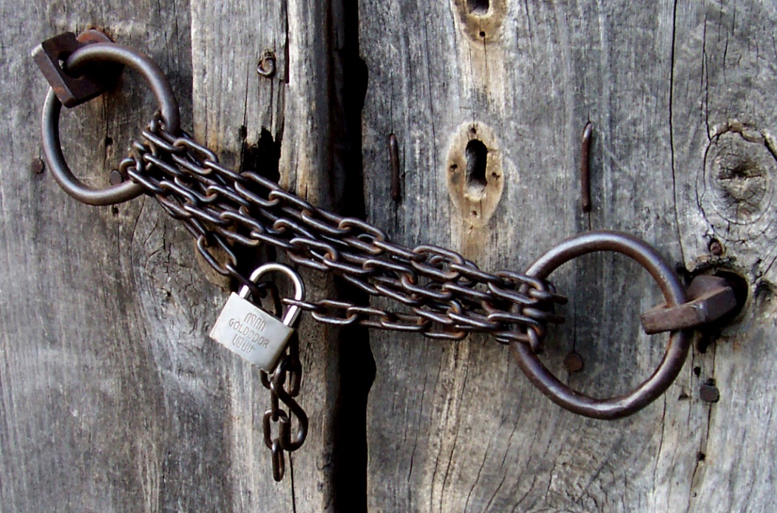
The Power of Secrets
Sarah Withee
Slides: geekygirlsarah.com/secrets
Twitter: @geekygirlsarah Feel free to tweet along.
Notes:
Good afternoon everyone.
Close your eyes for a moment.

Slide 2
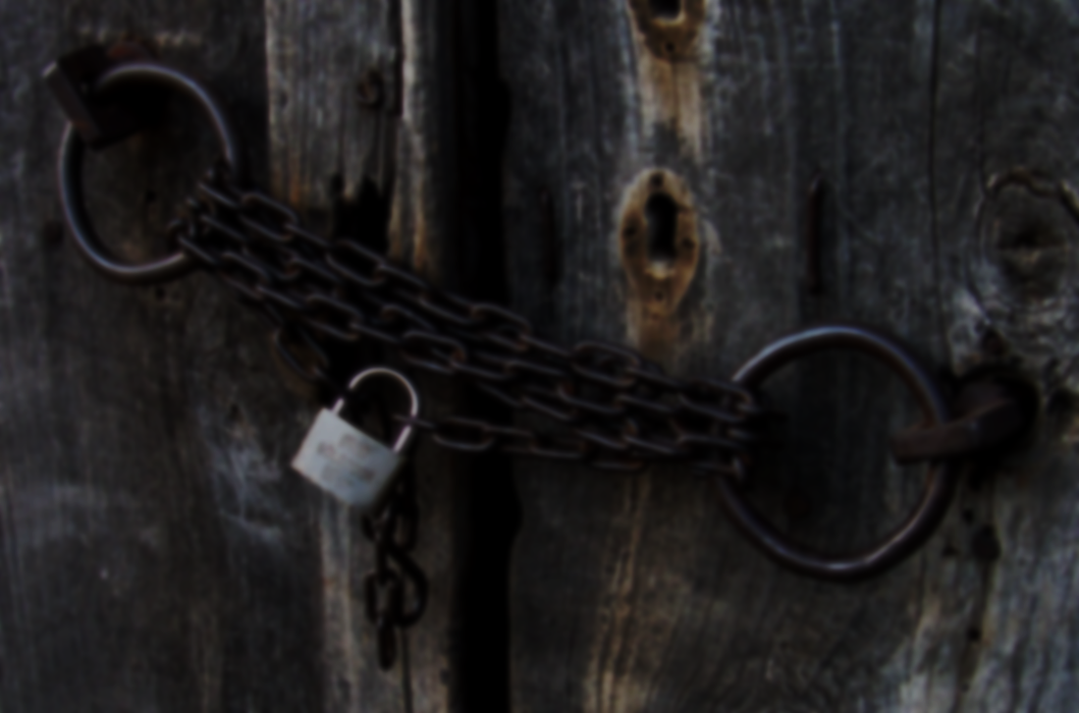
Notes:
Imagine you're with the person who is your best or closest friend. Maybe it's in real life, maybe online. Whatever your situation typically is. Now imagine you told them one of your roughest secrets. Are they comfortable with it? Do you feel like they're judging you? Are YOU comfortable with it? Now imagine it's a coworker instead. What about a manager at work? Your barista at a coffeeshop? What about just a random person from the internet? Are you still comfortable in these situations? Do you feel you COULD share this secret with these people? Alright, open your eyes. Look to your neighbor. If I asked you to share something with your neighbor, could you do it?

Slide 3
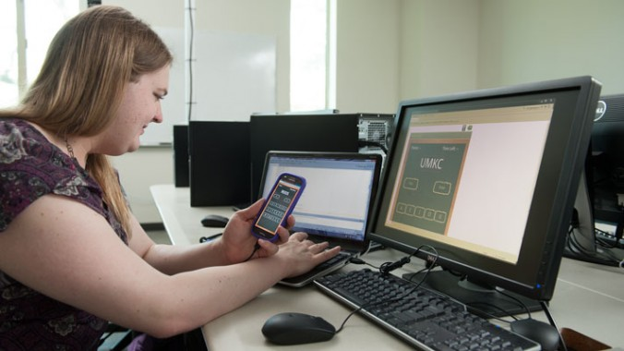
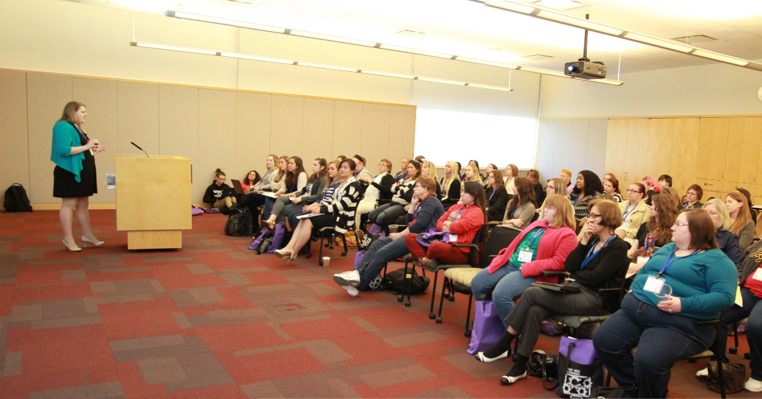
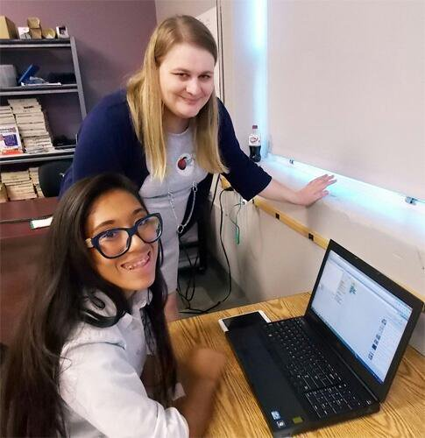
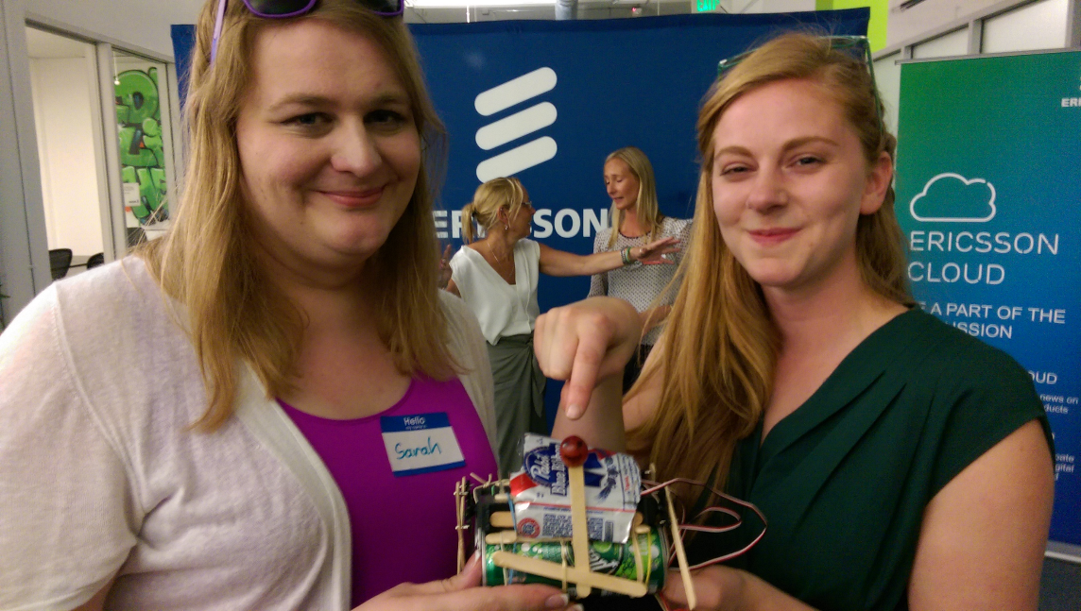
Hi. I’m Sarah.
@geekygirlsarah #alterconf
Notes:
Hi. I'm Sarah Withee, I'm a software engineer, speaker, teacher, and robot and hardware tinkerer. (Yes, that IS Simone Giertz holding a shitty robot I built.)

Slide 4
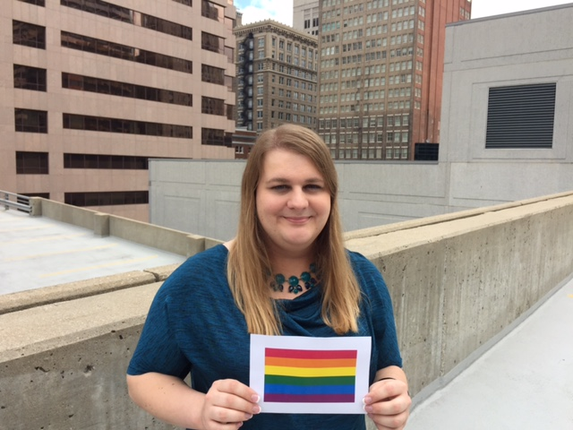
@geekygirlsarah #alterconf
Notes:
I'm also transgender.
[If others have spoken about this] I know it’s been explained today but I want to explain for the video.
[If not] So let me explain what this means real quick.
A person is transgender when their body’s sex doesn’t match up with their view of their mental gender. Studies have shown that gender really can be quite fluid and not just “man” or “woman”, and that bodies don’t even really fit into this either-or system all the time. There’s lots more research out there now than when I was kid, so go check it out.

Slide 5
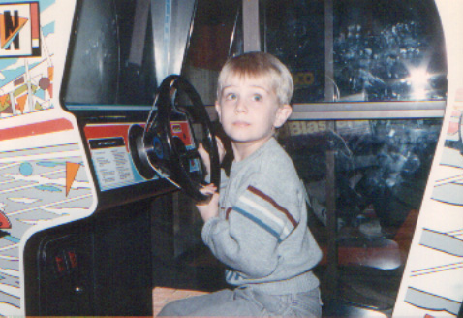
@geekygirlsarah #alterconf
Notes:
Anyway, for me, this meant that I was a woman but wasn’t born in a woman’s body.
And my story is NOT the same as everyone else’s story.
This is a picture of me when I was young. Obviously don’t look much like a little girl. I was cute though, right? And Pole Position is still a great game.

Slide 6
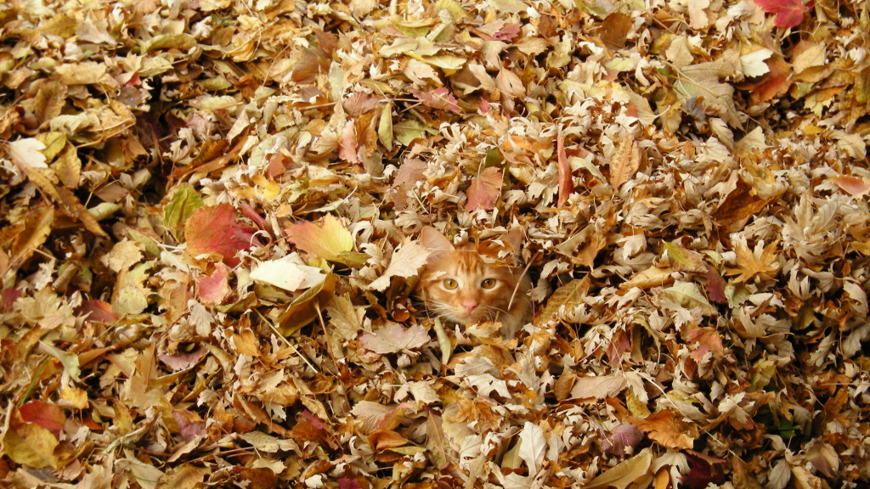
Being Stealth
@geekygirlsarah #alterconf
Notes:
So I’d like to talk about being stealth.
I was involved in the LGBTQ community for a while after my transition. I was very visibly trans in the beginning.
When I went back to school, I joined 3 geek/engineering organizations. I joined the LGBTQIA one too, but quickly was brought up to leadership in the geeky ones. I backed out of the LGBTQIA one. Kind of felt I didn’t need it. I was ok with who I was and where I was, besides, I was busy anyway.
It felt good to be stealth. Around so many people who saw me as a woman, who didn’t need to know my background. I ended up stealth after going back to school. People didn’t know, and it was a great feeling to just be accepted as a woman.
But doing this made things more difficult. Things like “When I was a little boy” had to change to “when I was a little kid”, and some things about my life just had to be cut out. Why did my parents disown me? Well.. Uh… they didn’t agree with my political beliefs. Just felt like a lot of hiding, and sometimes dismissing 24 years of my life.
The closer to graduation, I got involved in Slacks, made more Twitter friends, spoke at conferences. I was making networks. And quickly I saw they were merging.

Slide 7
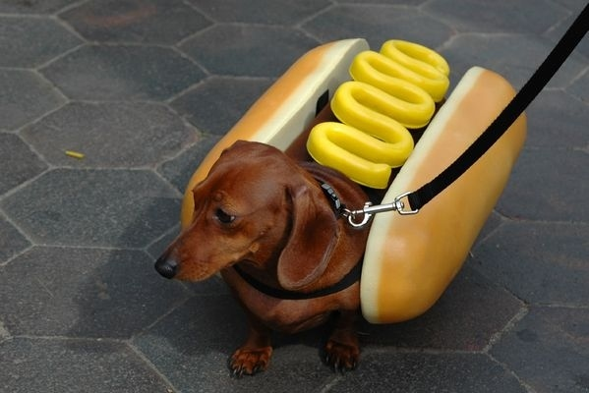
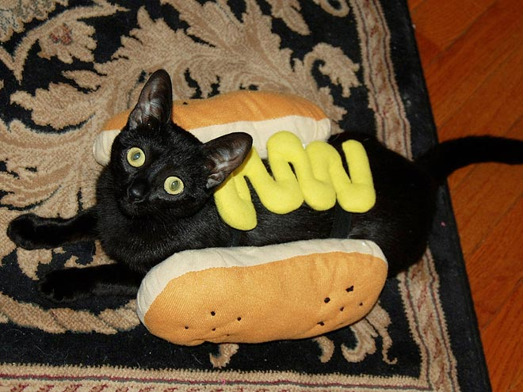
@geekygirlsarah #alterconf
Notes:
I started feeling like the world saw me how I wanted them to see me,
[CLICK]
but still felt like I was being this imposter. People would find me out.
I had to get my story out, and do it my way.
Twitter seemed too passé, and too easily skipped over. I should blog it.

Slide 8
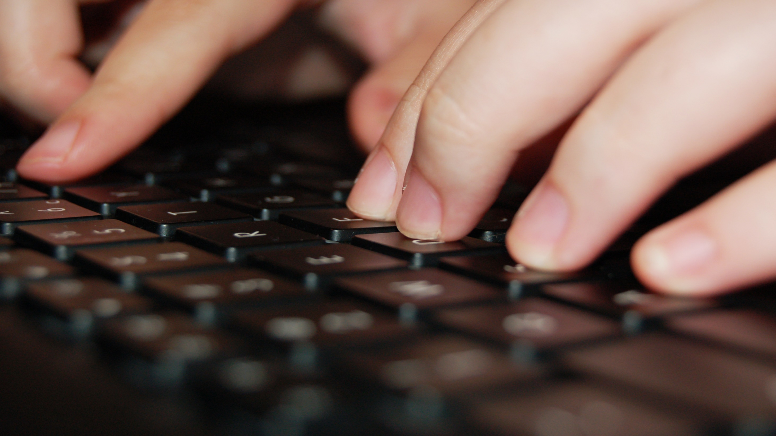
The Blog Post
@geekygirlsarah #alterconf
Notes:
So I wanted to do something powerful with this. I wanted to help people, encourage people, share a great story they could relate to, even if not trans or LGBTQ.
I knew several people have told me they thought I was brave or courageous. What if I went this route? Talked about my story and going the route from start to struggle to success?
So I wrote it out. I used Medium and did a draft. I sent it to a few friends, they offered some suggestions, and I rewrote parts. I did 7 revisions in the end, and had a ton of reviewers. I even asked on Twitter for the last one, and got a total stranger, Leigh Honeywell, to help. We followed each other, but never chatted before that. I was super scared, but she had a TON of constructive criticism.
I made a deadline: Tuesday, September 29th. I wrote out the tweets I was going to do. I was going to hit Publish on Medium. And it was going to be fine.

Slide 9
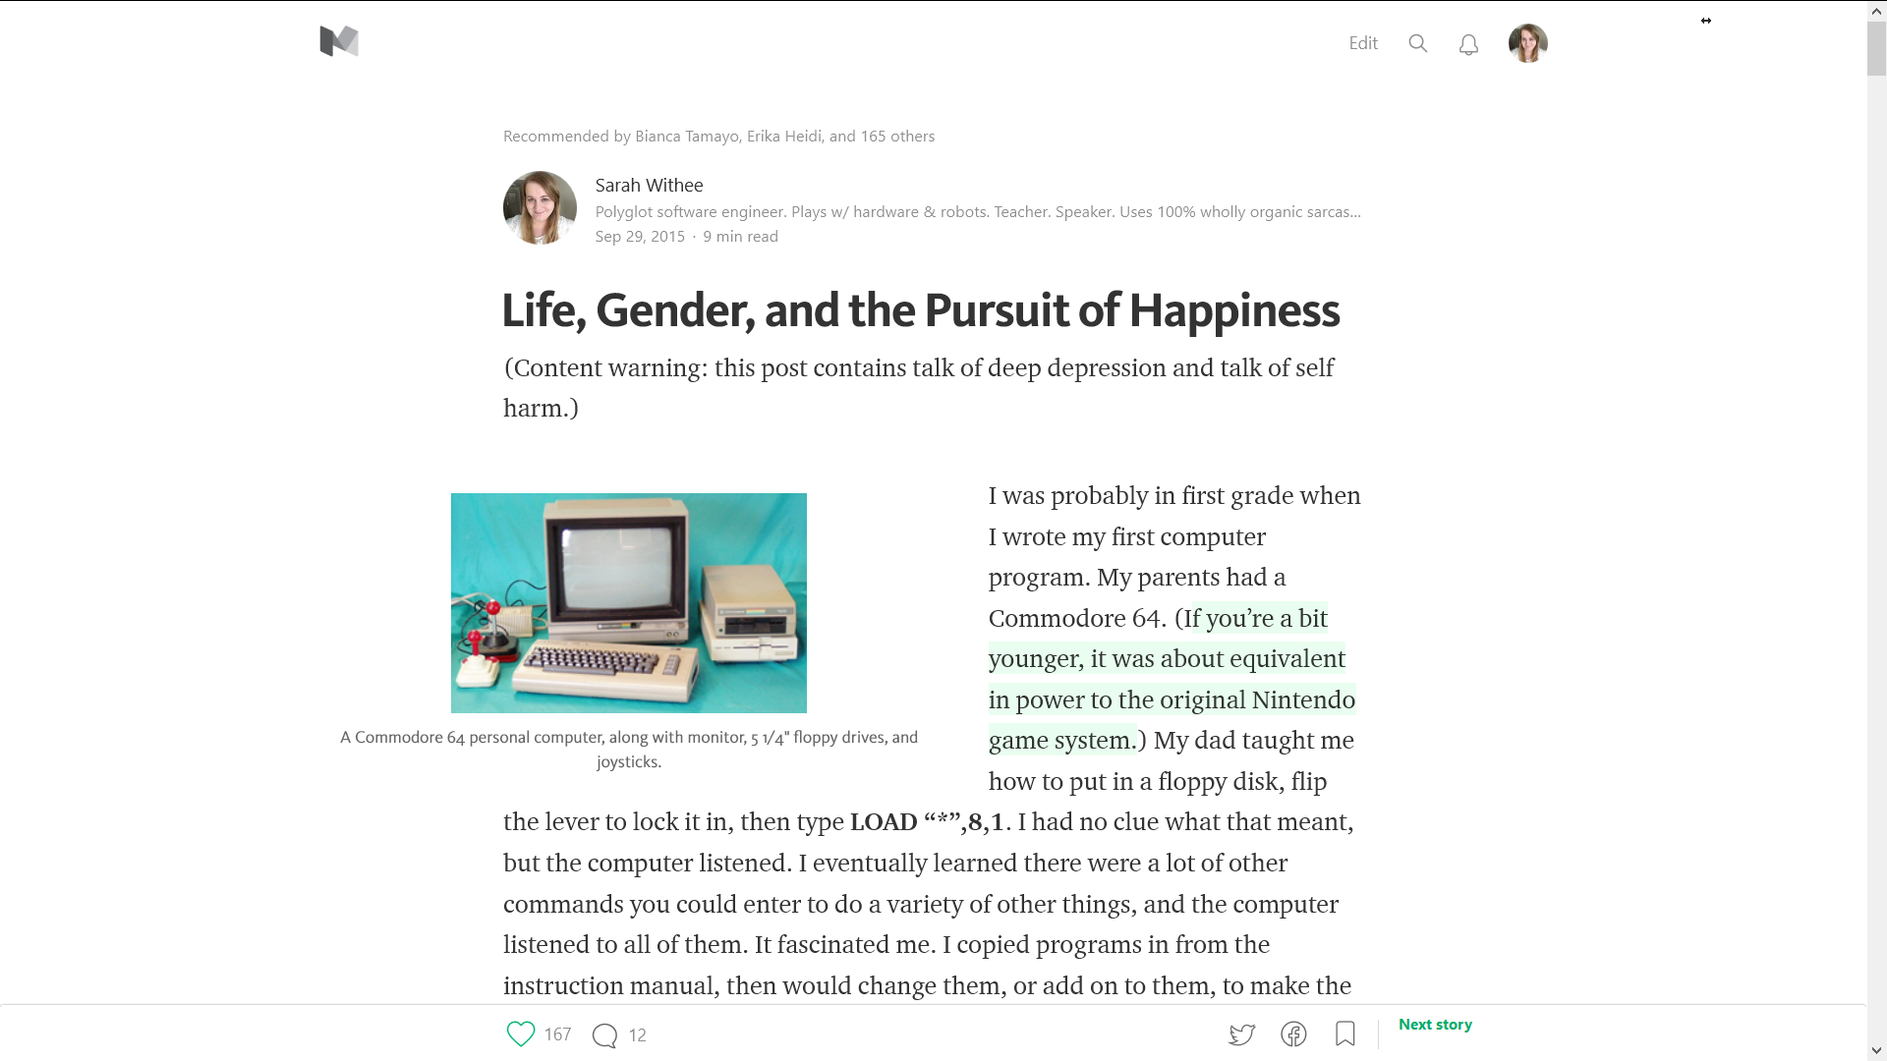
@geekygirlsarah #alterconf
Notes:
I wanted to do this during the day so more people would see it. So that afternoon I hit Publish on my post. It went live.

Slide 10
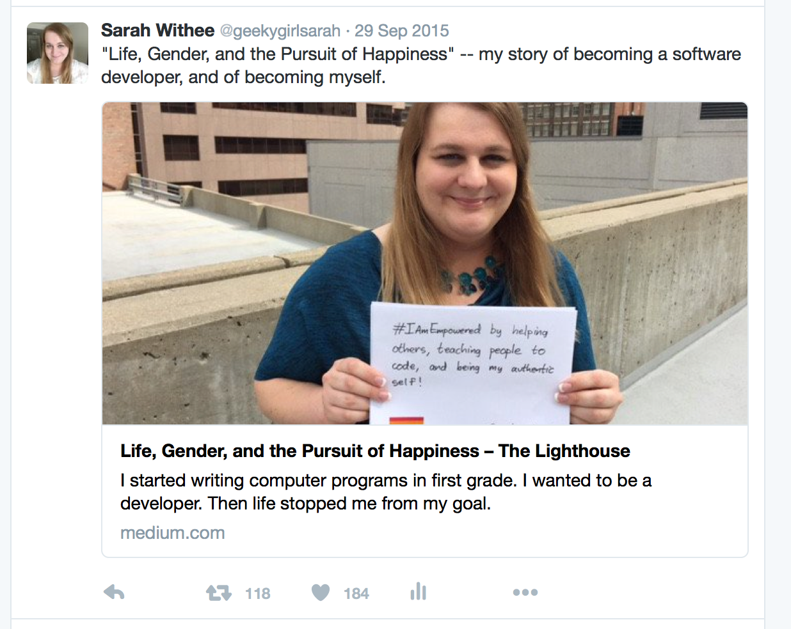
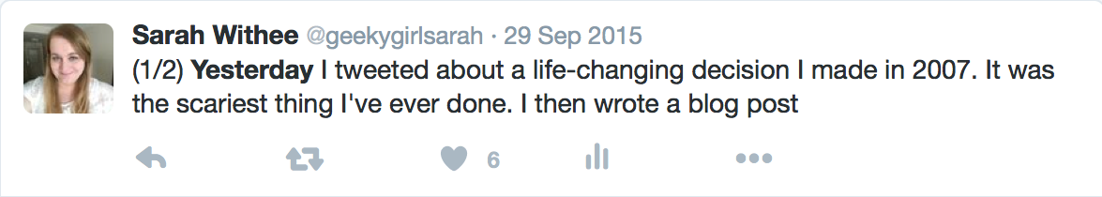
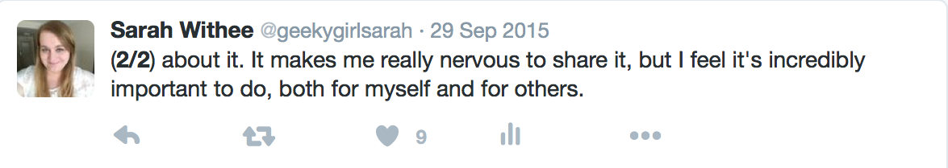
@geekygirlsarah #alterconf
Notes:
I copied and pasted my tweets from my text editor into Twitter.
And in the few seconds it took to do this… My heart sank into my stomach. I shouldn’t be doing this. I made a mistake. I shouldn’t come out. Oh gawd.
I finished the tweets, then grabbed my phone and ran to the restroom at work.

Slide 11
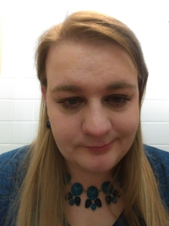
@geekygirlsarah #alterconf
Notes:
I copied and pasted my tweets from my text editor into Twitter.
And in the few seconds it took to do this… My heart sank into my stomach. I shouldn’t be doing this. I made a mistake. I shouldn’t come out. Oh gawd.
I finished the tweets, then grabbed my phone and ran to the restroom at work.
I sat in a stall. I was shaking. I was sobbing. I opened the LGBTQ in Tech slack. And I went to the #mental_health channel. And just said “Someone please tell me I didn’t just ruin my life?”
A coworker tracked me down, and after 45 minutes I calmed down. I wiped off my face, and went with her to a coffeeshop. She checked in on me. She calmed me down. And all the while, my phone was buzzing nonstop. Likes. Retweets. Recommendations. It was all happening so fast.
It was hoping maybe to 50-100 would see this…

Slide 12
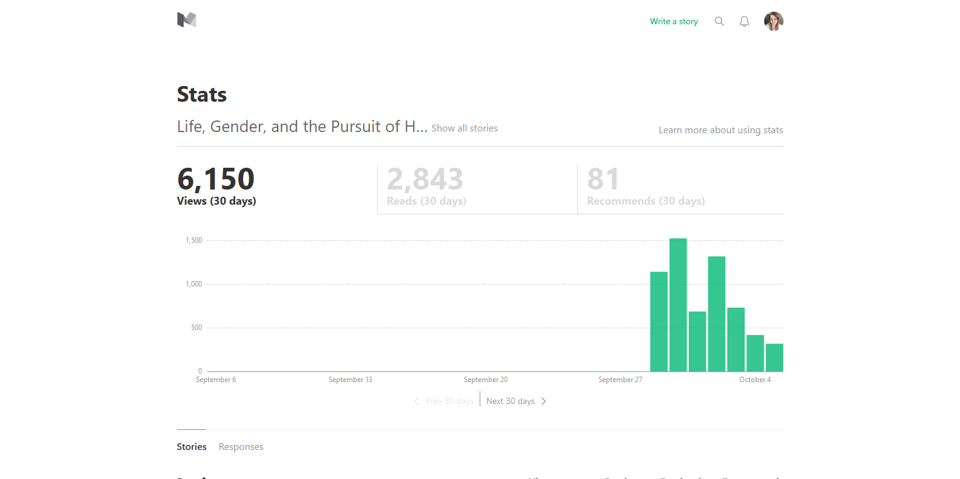
@geekygirlsarah #alterconf
Notes:
Within the first day over a thousand people had seen this. Within the first 3 days, several thousand had seen this. I didn’t even know this was a real possibility.

Slide 13
@geekygirlsarah #alterconf
(Door opening)
Notes:
But… I was out. For the first time in 8 years after transitioning… I was publicly out of the closet. And I knew I couldn’t go back in.
I had some fears about coming out publicly. I might lose friends. Maybe I might jeopardize current or future jobs. I might jeopardize the conference speaking I was doing. I mean… I knew trans people who came out and it was fine, but they were along the coasts. I live in the Midwest!
Also what if my friends, who just thought of me as a woman, now thought of me like a fake woman, or somehow I just dramatically altered their appearance of me?

Slide 14
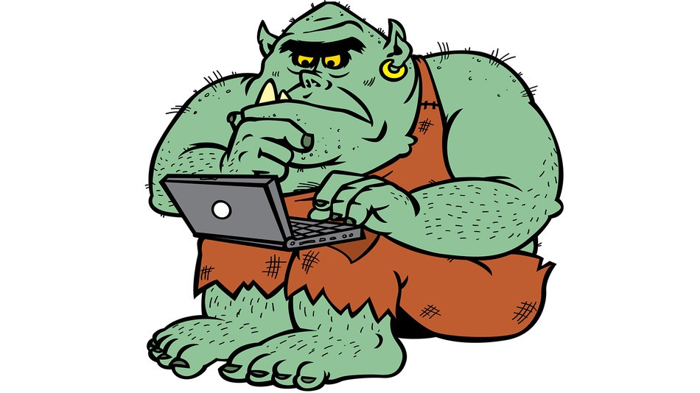
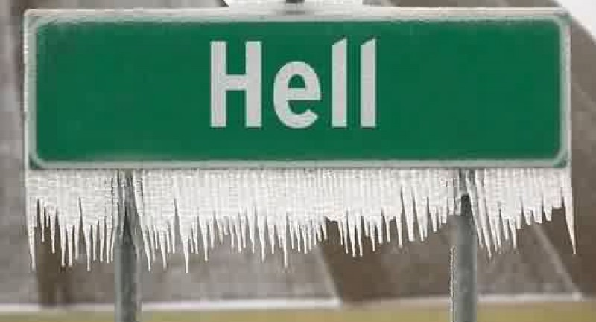
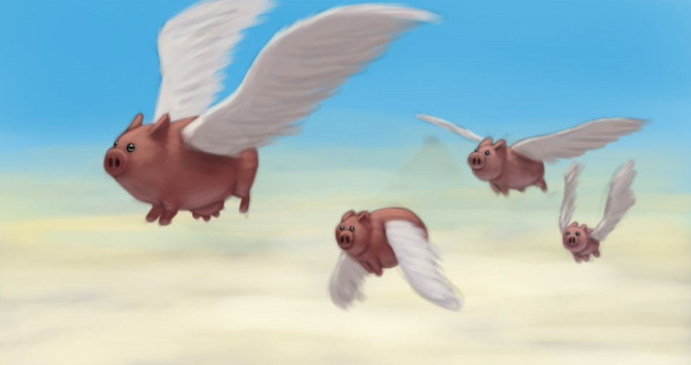
@geekygirlsarah #alterconf
Notes:
What if this started an attack of internet trolls coming after me? What if hell froze over? What if pigs started flying!?!?

Slide 15
@geekygirlsarah #alterconf
❌
❌
❌
Notes:
So… that didn’t happen. None of it. (Probably no surprise.)

Slide 16
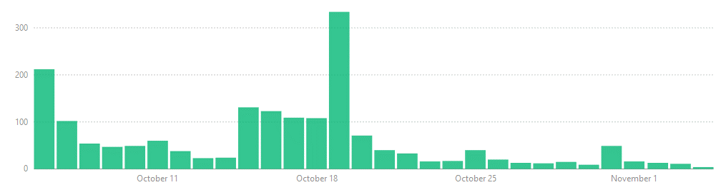
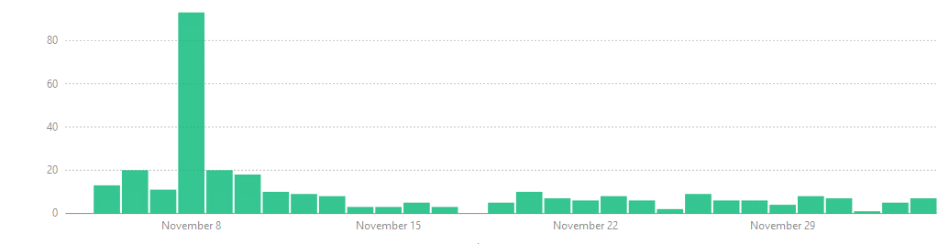
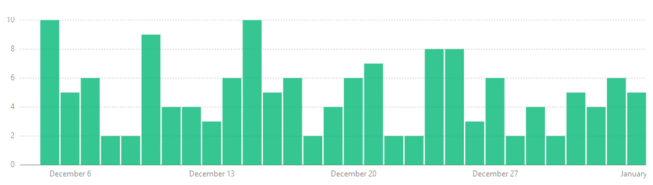
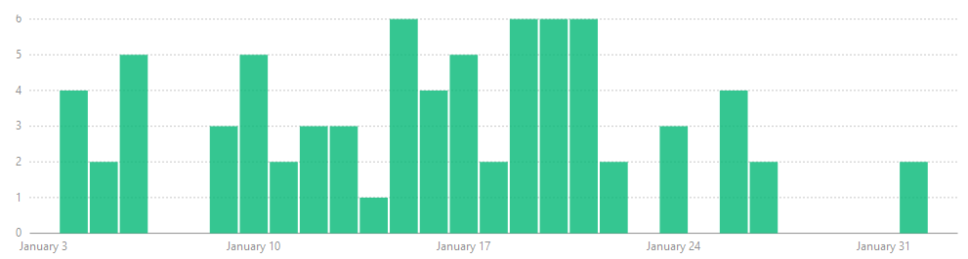
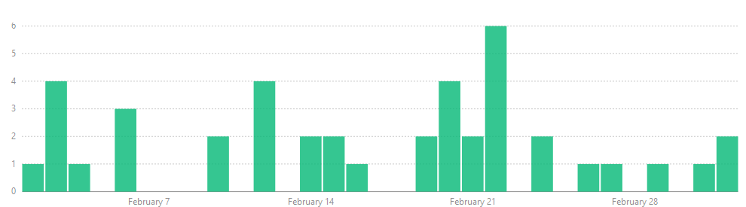
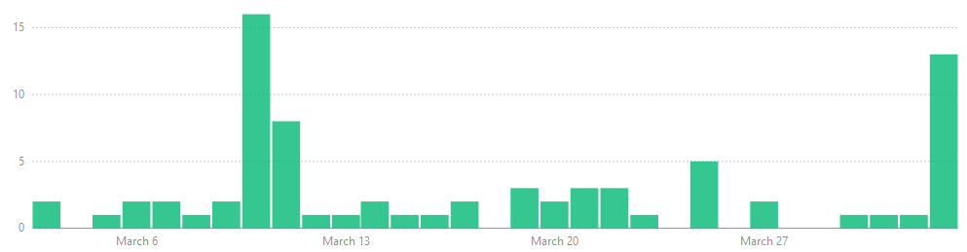
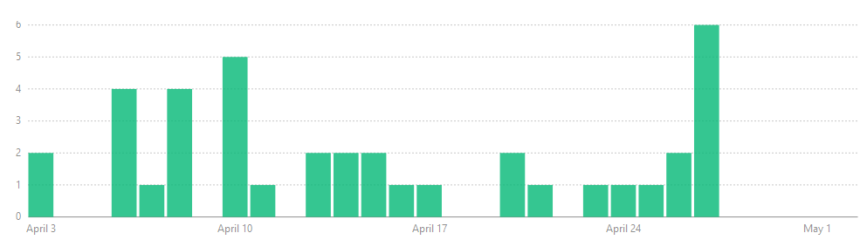
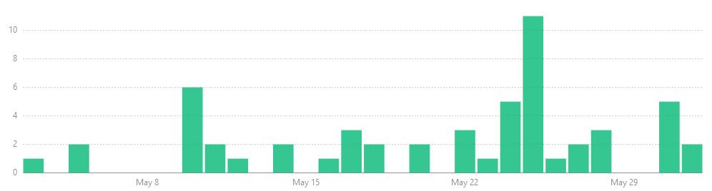
@geekygirlsarah #alterconf
Notes:
As I mentioned, the first 3 days had thousands of views. Even as time went on, this got so many recommendations on Medium, as well as likes and retweets on Twitter. Every time I looked at how many emails I had or I looked at Medium’s stats, I was floored that this continued. People kept reading this. They kept sharing it. This slide shows 8 months of views. They decreased over time, but for the most part, some person read this post every day for a full year.. This became the most popular thing I had ever done.

Slide 17
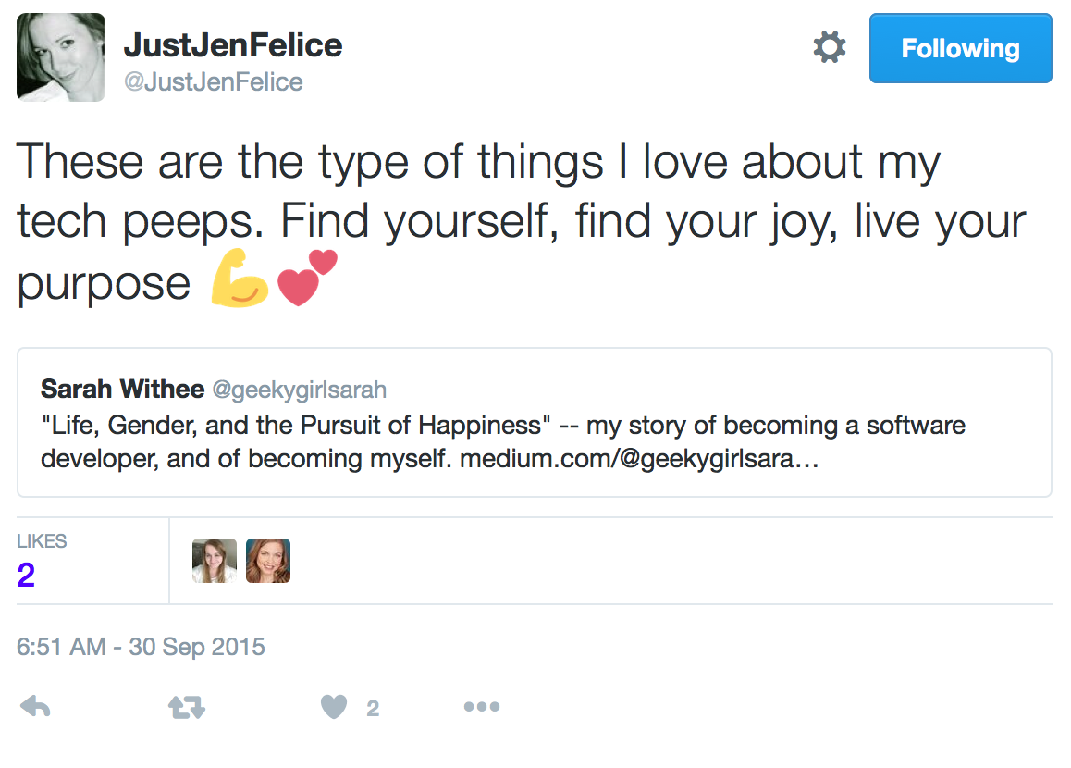
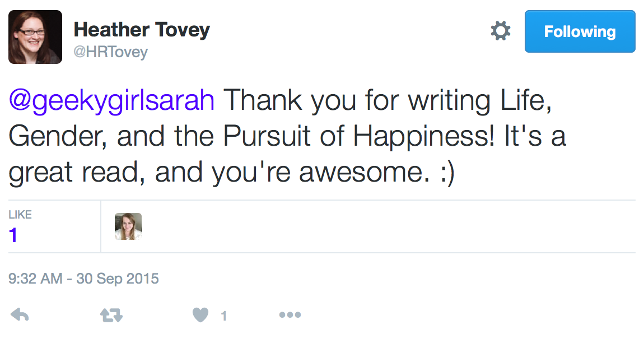
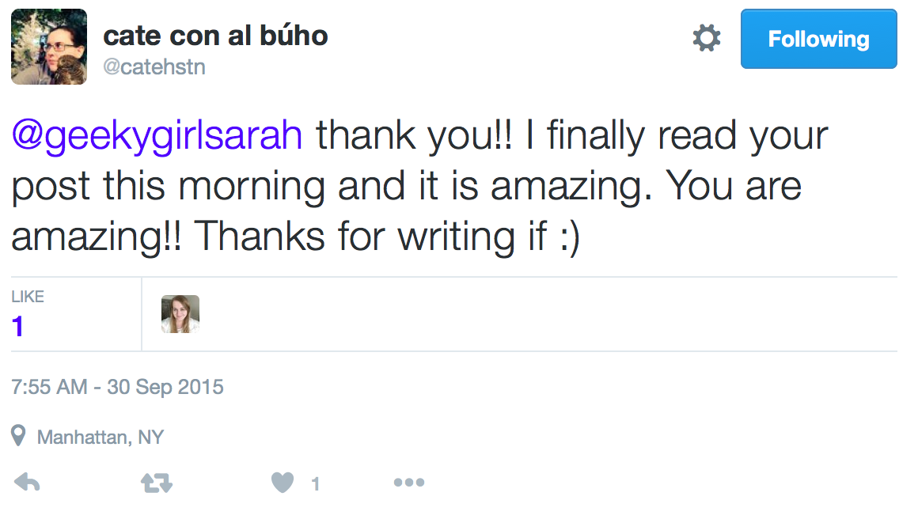
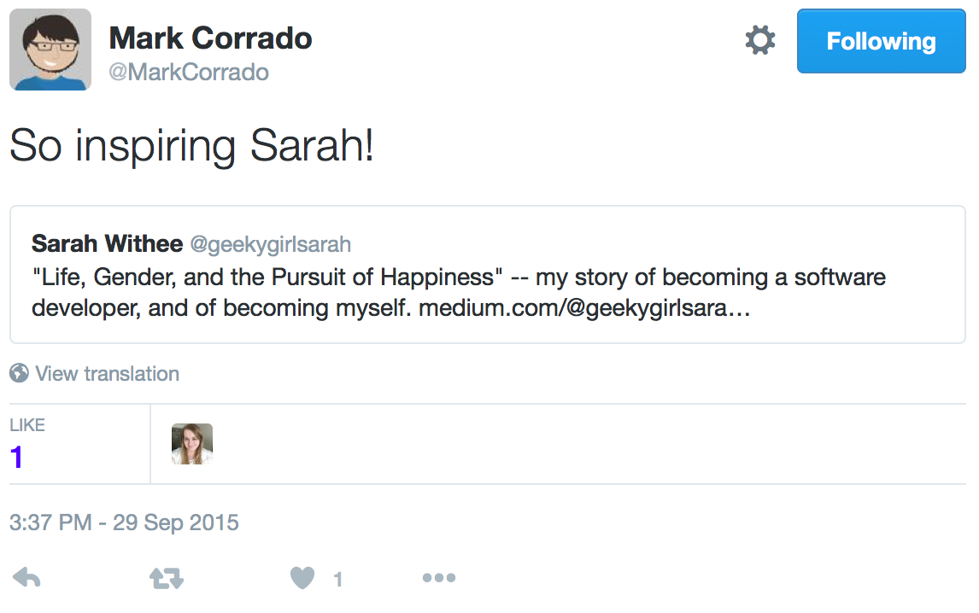
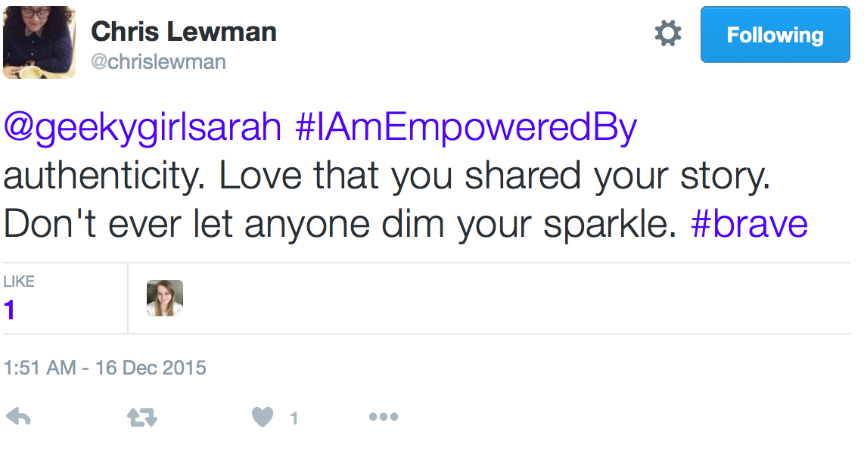
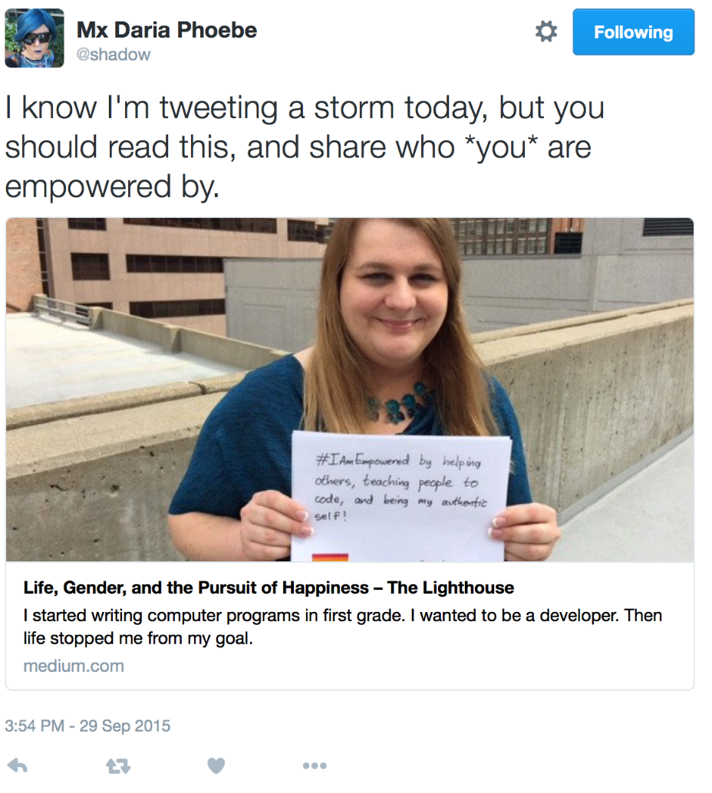
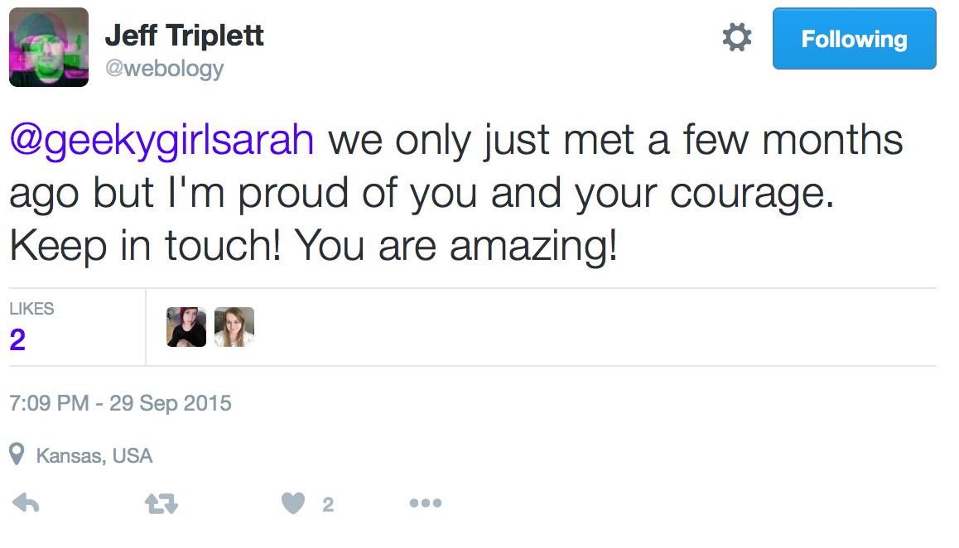
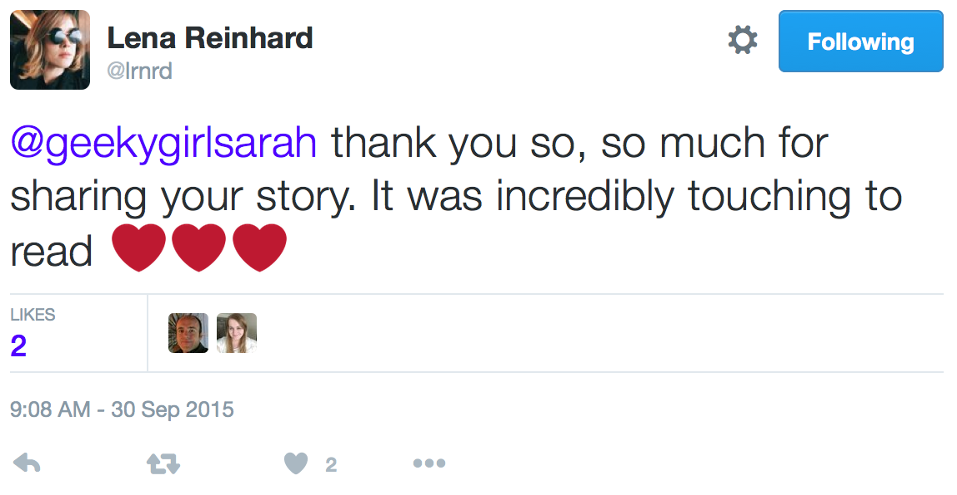
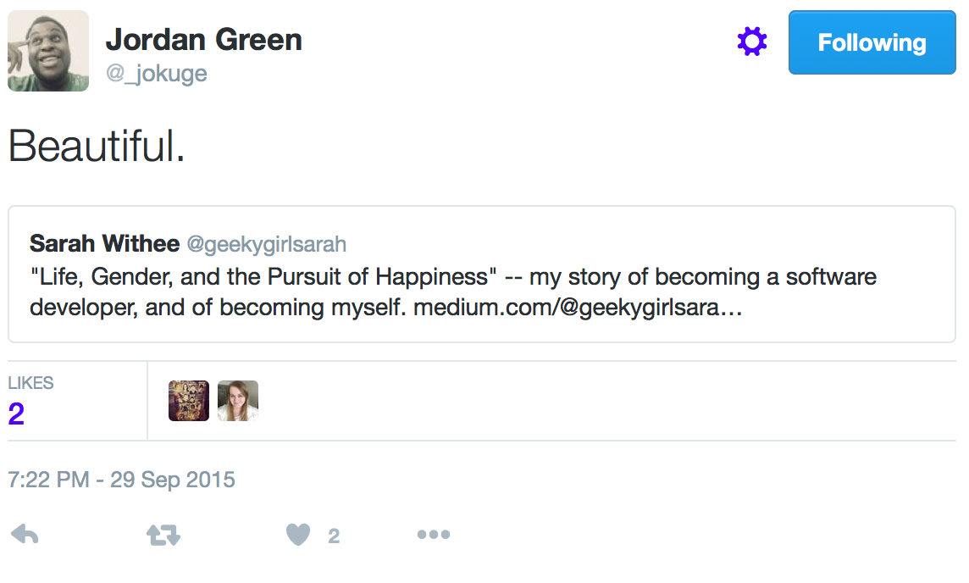
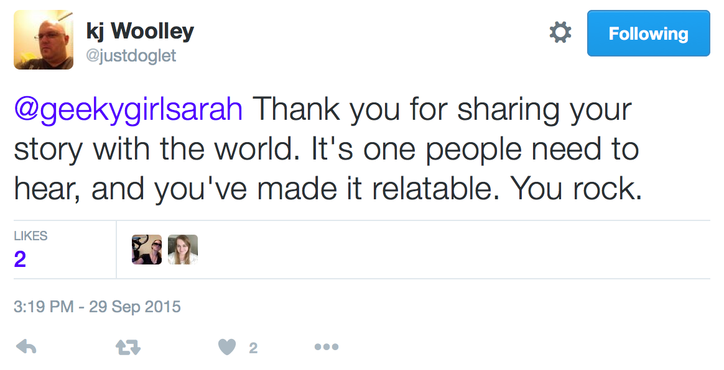
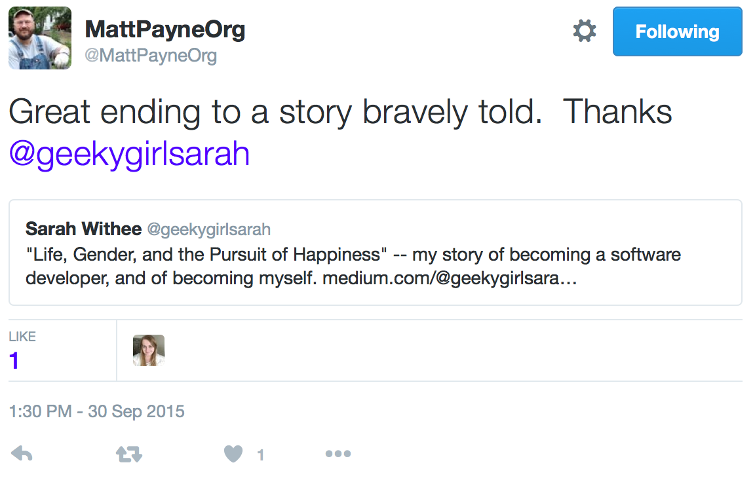
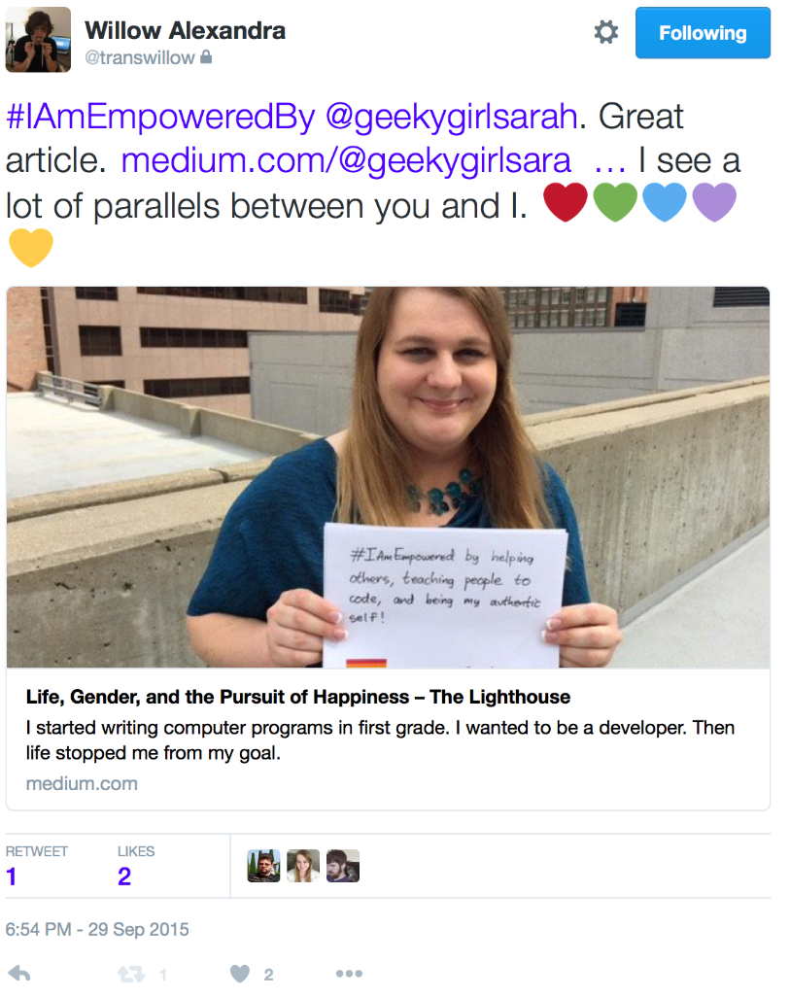
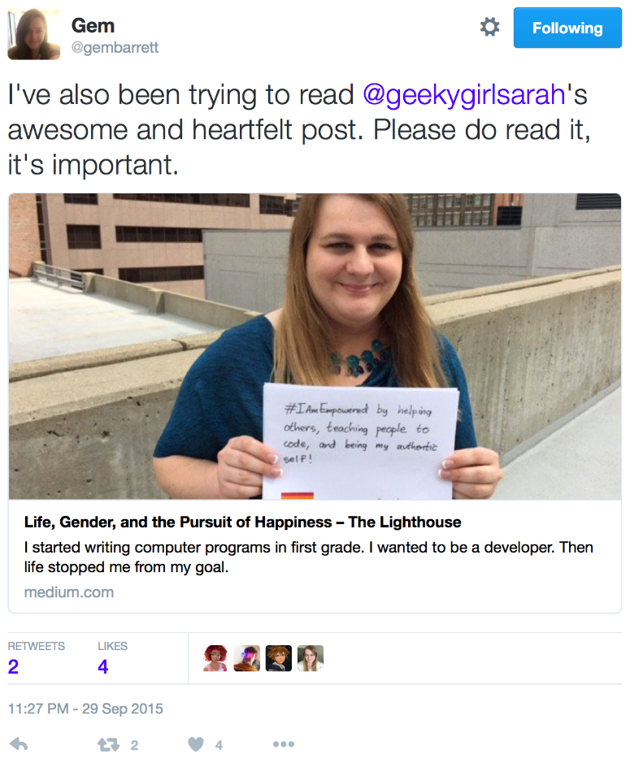
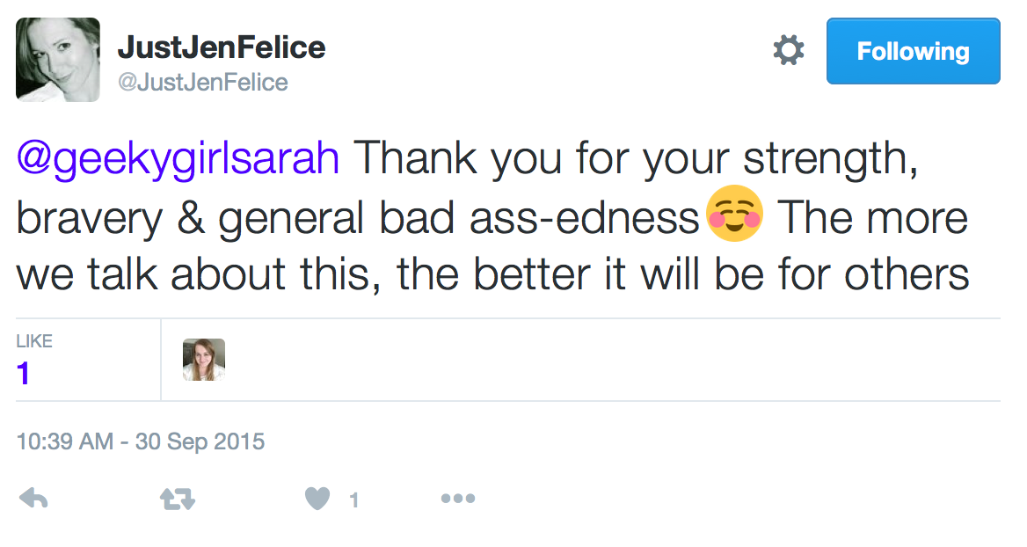
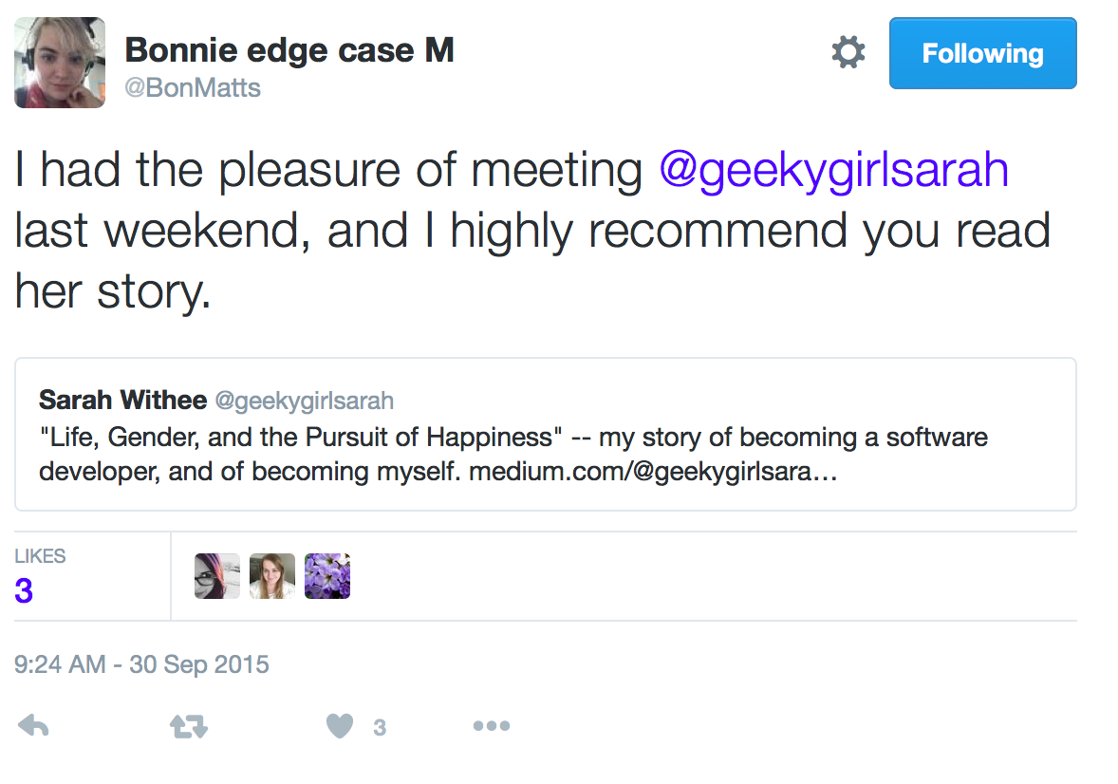
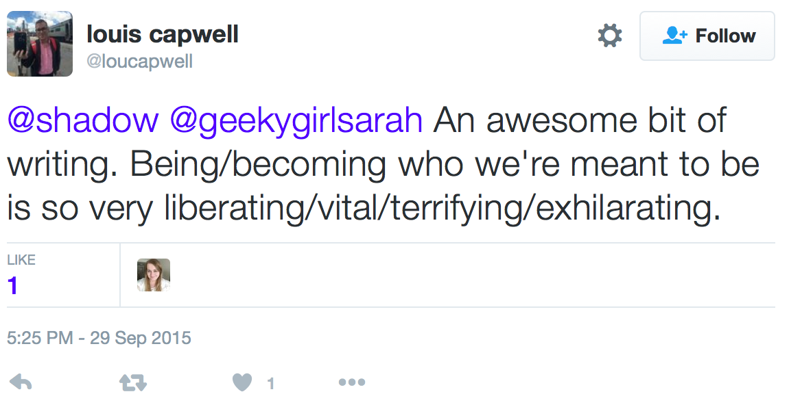
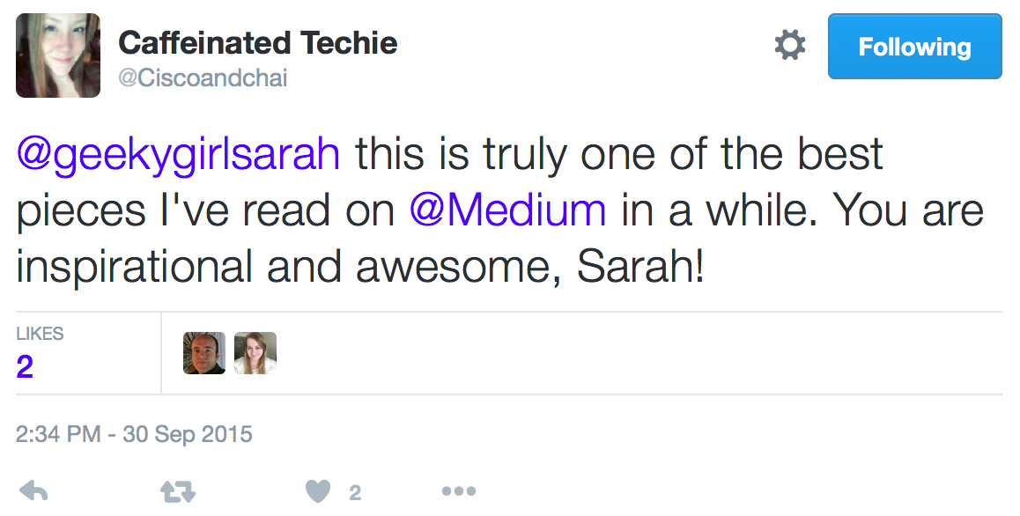
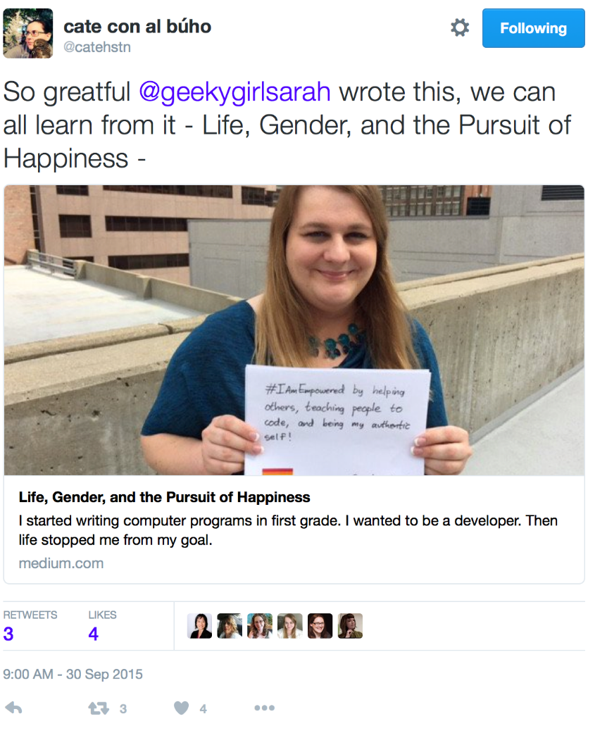
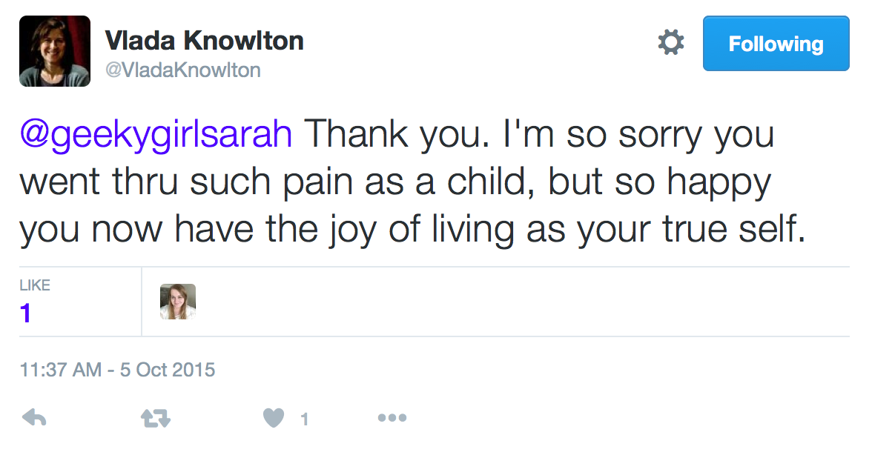
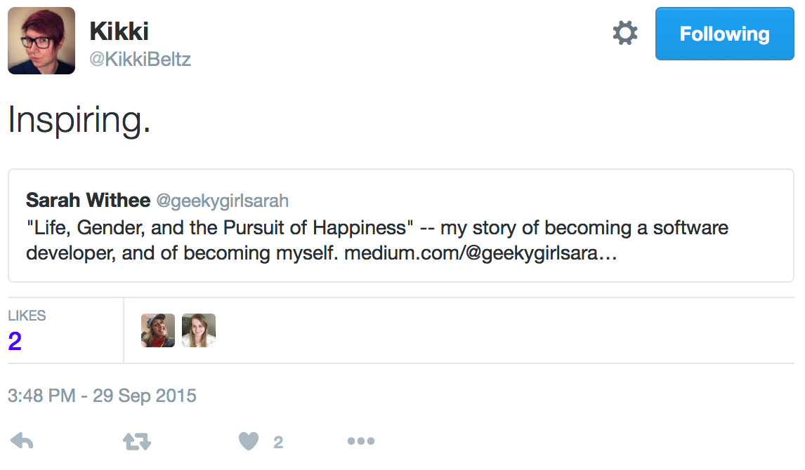
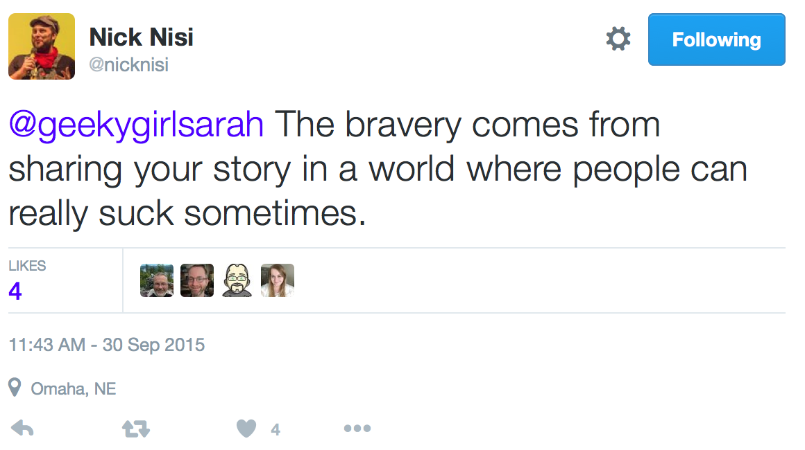









@geekygirlsarah #alterconf
Notes:
What else happened? People started messaging me. All the time. They thanked me, told me this post was brave or courageous, what a great read it was, and so many more great things…

Slide 18

@geekygirlsarah #alterconf
Notes:
… they came out to me (sometimes already out, sometimes not)…

Slide 19

@geekygirlsarah #alterconf
Notes:
… they told me how they related to my depression struggles, or some giant hurdle to overcome in their life to be successful, or some other way they connected with this story…

Slide 20

@geekygirlsarah #alterconf
Notes:
… people even went out of their way to anonymously send me messages to not out themselves, but still tell me how they loved my post.

Slide 21

@geekygirlsarah #alterconf
Notes:
People were doing the exact opposite thing of what I feared. I had 100% positive things happen from this. I made more friends. Current friends told me they read it and it was great. Other speakers told me this. At least a dozen people told me they cried reading it.

Slide 22

@geekygirlsarah #alterconf
Notes:
Even one year later I still hear from others about my post. The stats above I took at the airport yesterday. The spoke at the end was me tweeting about the 1 year anniversary but… it’s still got reads nearly every day this month. I still am surprised when I get another message from it. How did this story ever come to affect SO many people?
And as they shared more stories with me, I slowly felt this weight come off my shoulders. I still have my scary feelings, but it was way more amazing than I ever dreamed during the months I was dreaming this post up.

Slide 23

On Becoming Vulnerable
@geekygirlsarah #alterconf
Notes:
So why did I just tell that really long story about a blog post? It’s because I’ve spent the past year reflecting on vulnerability.
How many of you think of vulnerability as a bad thing?
When we think about vulnerability, we tend to think bad things. We tend to think about a person in a dark alley and what bad might happen to them.

Slide 24

@geekygirlsarah #alterconf
Notes:
We think about that woman from that horror film who is in the woods alone and you know something’s going to attack her.

Slide 25
@geekygirlsarah #alterconf
(friendship)
Notes:
What if I told you that vulnerability is a good thing?
I think it’s the basis of a great friendship. Are you best friends with someone because of the weather, or because they have a cute pet, or they read the same book you do? Probably not. You’re likely best friends because you bonded over something vulnerable. Some shared experience. Or just sharing important, deep experiences.

Slide 26

@geekygirlsarah #alterconf
Notes:
Brené Brown studies human connections. She set out to study some of them. In her TEDx talk, she said “I know vulnerability is kind of the core of shame and fear and our struggle for worthiness, but it appears that it’s also the birthplace of joy, of creativity, of belonging, of love.” I love this quote.
Think about it: don’t you fear the unknown more than the known?
Can you be creative if you know the exact outcome?

Slide 27

%
@geekygirlsarah #alterconf
“I know vulnerability is kind of the core of shame and fear and our struggle for worthiness, but it appears that it’s also the birthplace of joy, of creativity, of belonging, of love.”
- Brené Brown
“The Power of Vulnerability”
Notes:
Brené Brown studies human connections. She set out to study some of them. In her TEDx talk, she said I love this quote.
Think about it: don’t you fear the unknown more than the known?
Can you be creative if you know the exact outcome?

Slide 28

@geekygirlsarah #alterconf
Notes:
Bob Ross, everyone’s favorite painter, likes to say “there are no mistakes, just happy accidents.” He encourages you to try something new, even when you don’t know the result. But, even those mess-ups are still great. Actually watch his videos and listen… he’s always encouraging the viewer to do something new and different, and never tells you how to “correct” it because how it turns out is right as it is.

Slide 29

@geekygirlsarah #alterconf
“There are no mistakes, just happy accidents.”
- Bob Ross
Notes:
Bob Ross, everyone’s favorite painter, likes to say “there are no mistakes, just happy accidents.” He encourages you to try something new, even when you don’t know the result. But, even those mess-ups are still great. Actually watch his videos and listen… he’s always encouraging the viewer to do something new and different, and never tells you how to “correct” it because how it turns out is right as it is.

Slide 30
@geekygirlsarah #alterconf
(group of people)
Notes:
Vulnerability is what makes humanity real.
When was the last time you thought someone was so perfect, and you didn’t like them because yours was imperfect? If they told you all of the things going wrong in their life that you didn’t see, would you change your views of them?

Slide 31



@geekygirlsarah #alterconf
Notes:
Remember Post Secret? The site where you mailed in postcards with deep secrets and they were posted on the website anonymously? On the left is a screenshot of a few postcards from this week. On the right is a screenshot of the whole site from this week. There are 45 postcards. That’s just what he received last week and posted. And if you’ve read the site, how many of these have you felt sympathy for? How many of them have reminded you of your own stories?
When you learn people have flaws and faults, they become more real. More human. More capable of mistakes and hurt and everything you face too. And generally, the more you trust them. The better your friendships become.

Slide 32

@geekygirlsarah #alterconf
Notes:
Vulnerability is also what makes teams more productive.
Google did a study trying to find what composed a “perfect” team. They spent years trying to figure it out. Were teams the most productive with certain ages? Genders? Experience levels? Locations they were from? No combination of variables really seemed to result in anything. Except when they finally looked at how close teams were. Empathy levels. The teams that were more connected on personal levels worked better. Made better products.
Think about it: If you’re scared to ask questions of your team, or scared to tell them if you’re stuck, it affects the whole team. You’re less productive. If you’re afraid of what they think, then you’ll be more self-conscious of your work. More relaxed teams that are comfortable with each other won’t judge each other (or worry about being judged). Everyone benefits from this. After all, if you’re stuck, don’t you feel a bit vulnerable asking for help?
Don’t get me wrong. Being vulnerable IS scary. Anytime a friend rejects us for something we said or did, anytime someone laughs at an idea of ours, anytime we try something new and it fails… these are all legitimately scary things. But without these, we don’t grow as people. We don’t become stronger. We don’t become smarter. We just remain fairly stuck where we are.

Slide 33
@geekygirlsarah #alterconf
Stereotypical picture of team
Notes:
Vulnerability can also make teams more productive.
Google did a study trying to find the most productive team and what it looked like. The Wall Street Journal has an article on it. Long story short, After years of research, they learned it wasn’t age groups, genders, experience levels, or anything else. Empathetic teams were the most connected, and because of that, were the most productive.
Think about it: If you’re scared to ask questions of your team, or scared to tell them if you’re stuck, it affects your productivity. If you’re afraid of what they think, then you’ll be more self-conscious of your work. But it also affects the whole team too. More relaxed teams that are comfortable with each other won’t judge each other (or worry about being judged). Everyone benefits from this. After all, if you’re stuck, don’t you feel a bit vulnerable asking for help?
Don’t get me wrong. Being vulnerable IS scary. Anytime a friend rejects us for something we said or did, anytime someone laughs at an idea of ours, anytime we try something new and it fails… these are all legitimately scary things. But without these, we don’t grow as people. We don’t become stronger. We don’t become smarter. We just remain fairly stuck where we are.

Slide 34
Embracing Vulnerability
@geekygirlsarah #alterconf
(friends?)
Notes:
What happens when I started embracing vulnerability?
I connect with more people. There’s networking where you just briefly meet someone (and this isn’t bad, I want to network with all of you), but after I published that post, I connected with people. We had something we already bonded about. I was telling someone I know about a bankruptcy I filed in 2009. Turns out she was thinking about doing it, and had a lot of questions I could help answer. We connected over that.
I also discovered I’m thankful when my friends share their stories. I find these people more real. Their imperfections help me accept mine better. And I always make sure to tell them thank you. If they feel comfortable sharing, then that’s a good thing! [you can be that friend and offer that gift.]

Slide 35

Embracing Vulnerability
@geekygirlsarah #alterconf
Notes:
I slowly start to try new things. Sometimes scary things.
I’m trans, and all my life have been very self-conscious about my voice. But when I realized earlier this year that not only was I singing, and I loved it, I got curious. I recorded me singing (very nervously) and sent it to some friends. “How much do I suck,” I asked. Unanimously they said I didn’t. I was good. I was on-key. This isn’t something I thought about.

Slide 36

@geekygirlsarah #alterconf
Notes:
And when Kansas City started the Heartland Trans Chorus, I joined. And I sung at Pride this year. In front of people! And then I tried out for the Kansas City Women’s Chorus two weeks ago…

Slide 37

@geekygirlsarah #alterconf
Notes:
I didn’t make it. I was disappointed. I felt like a failure kind of. But the director wants to personally work with me. She sees my potential. So we scheduled this and will start soon.
I believe embracing vulnerability helps our teams too.

Slide 38

@geekygirlsarah #alterconf
Notes:
As I mentioned before, not having to fear about how we look to our teammates is amazing. I started a new job a little 2 months ago. I started this job knowing I would have a huge learning curve. I work at a medical science research institute. The software is so big, but it’s also just plain complicated because of the scientists’ requirements. For as often as I feel I’m not working fast enough or good enough, my team has been there encouraging me. They tell me they think I’m doing great for where I am. They are impressed how fast I learned two new frameworks in about a week. 5 of the 8 of the developers went to my talks at my last conference I spoke at. Their encouragements have helped me feel less fearful. Compare this to my last job where I had multiple managers that didn’t communicate with me, I had a constant fear I was doing things wrong, and got to be too nervous to ask questions. One of the highly respected senior developers actually laughed in my face when I was stuck and had to ask him a question.
Imagine what we could we achieve if our teams were more connected, and we helped each other out in the face of feeling vulnerable?

Slide 39
@geekygirlsarah #alterconf
Notes:
Vulnerability is scary. Secrets are scary. I should know. I admitted to a group of [##] people that I’m trans. I posted a picture of me crying after posting the scariest blog post I ever wrote. And this is all recorded and going on the Internet. There’s a good chance most of my team at work is going to watch this. There were many times I thought about emailing Ashe and saying “I changed my mind.” But vulnerability enhances our lives and helps us grow as people. I know I’m a better and stronger person after giving this talk, and I hope you see how this can work for you too.

Slide 40
Notes:
So close your eyes for me. Think about that best friend again. Do you feel that connection with them? Is it based on liking the same kinds of pets, or is it based on something deeper? Would you be able to tell them something else about you? What about your coworker or boss? What about your neighbor sitting next to you? It may still be scary, but how would these relationships be if they had a more authentic you? Would your work life improve?
Open your eyes.
I challenge you to think on this. Maybe the end result isn’t as scary. Maybe things will be fine. And maybe there’s more positive power from your secrets than you thought.

Slide 41
Sarah Withee
@geekygirlsarah
sarah@sarahwithee.com
Slides: geekygirlsarah.com/secrets
Notes:
My name is Sarah Withee. I’m @geekygirlsarah on Twitter. I’d love to hear your stories on how this as affected you and how you’ve embraced vulnerability. Please email or tweet me. Thank you.

